Slide 1

 | Madhav Institute of Technology & Science, Gwalior
 | (A Govt. Aided UGC Autonomous & NAAC Accredited Institute Affiliated to RGPV Bhopal) (Established in 1957)
The MITS Family
WELCOMES
The Newly admitted students
of
First Year
A Presentation
BY
Dr. MaNJAREE PANDIT,
Professor, Department of Electrical Engineering
&
Dean, (Academics)

Slide 2
Presentation Overview
Vision & Mission of the Institute
History of MITS
Introduction to Flexible Curriculum
Rules for promotion to higher classes
Courses Being Offerred at MITS
Flexible Curriculum
Guidelines for earning Additional Credits through MOOCs
Guidelines for Getting Honours or Minor
Specialization with B.Tech Degree
Participation in feedbacks & surveys

Slide 3
Vision
“To create world class quality engineers and technocrats capable of providing leadership in all spheres of life and society”
Mission
To provide quality education in technical and allied disciplines.
To organize and arrange innovative courses in Engineering and Technology.
To arrange vocational courses in the upcoming fields and innovative subjects to meet global advancements.
To promote research in the fields of technology and science.
VISION & MISSION

Slide 4
History of MITS
The foundation stone of the Institute was laid by Late Dr. Rajendra Prasad, the first President of India on 20th October, 1956.
The building was inaugurated on 11th December, 1964 by Late Dr. S. Radhakrishnan, the then President of India.
The Golden Jubilee Celebration of the institute was preceded by the then president of India, Mrs. Pratibha Devisingh Patil
The institute recently celebrated Diamond Jubilee in 2017.
The alumni are very highly placed globally.
The institute is accredited by NAAC.

Slide 5
History of MITS Autonomy
Till 2000-01 MITS was affiliated to the Jiwaji University, Gwalior
For the last 19 years now MITS is an Autonomous Institute under the Rajiv Gandhi Proudyogiki Vishwavidyalaya (RGPV) Bhopal
The degree however is conferred by the university (RGPV)
With effect from July 2017, MITS was granted autonomy for 6 years by the University Grants Commission (UGC) which permits MITS to
Have its own courses and syllabi and
Evolve methods of evaluation and conduction of examination

Slide 6
Present Status
There are 10 Under Graduate and 09 Post Graduate full time programs being offered.
The UG intake is 880 students and PG intake is 183.
There are 100 plus Ph.D Scholars registered at MITS under different departments.

Slide 7
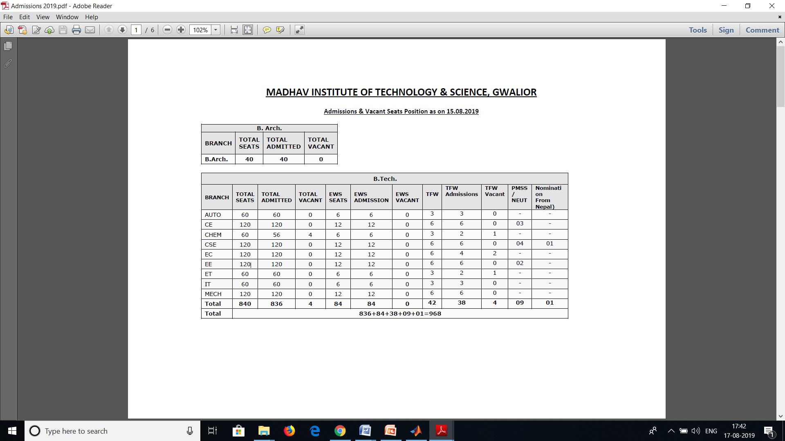
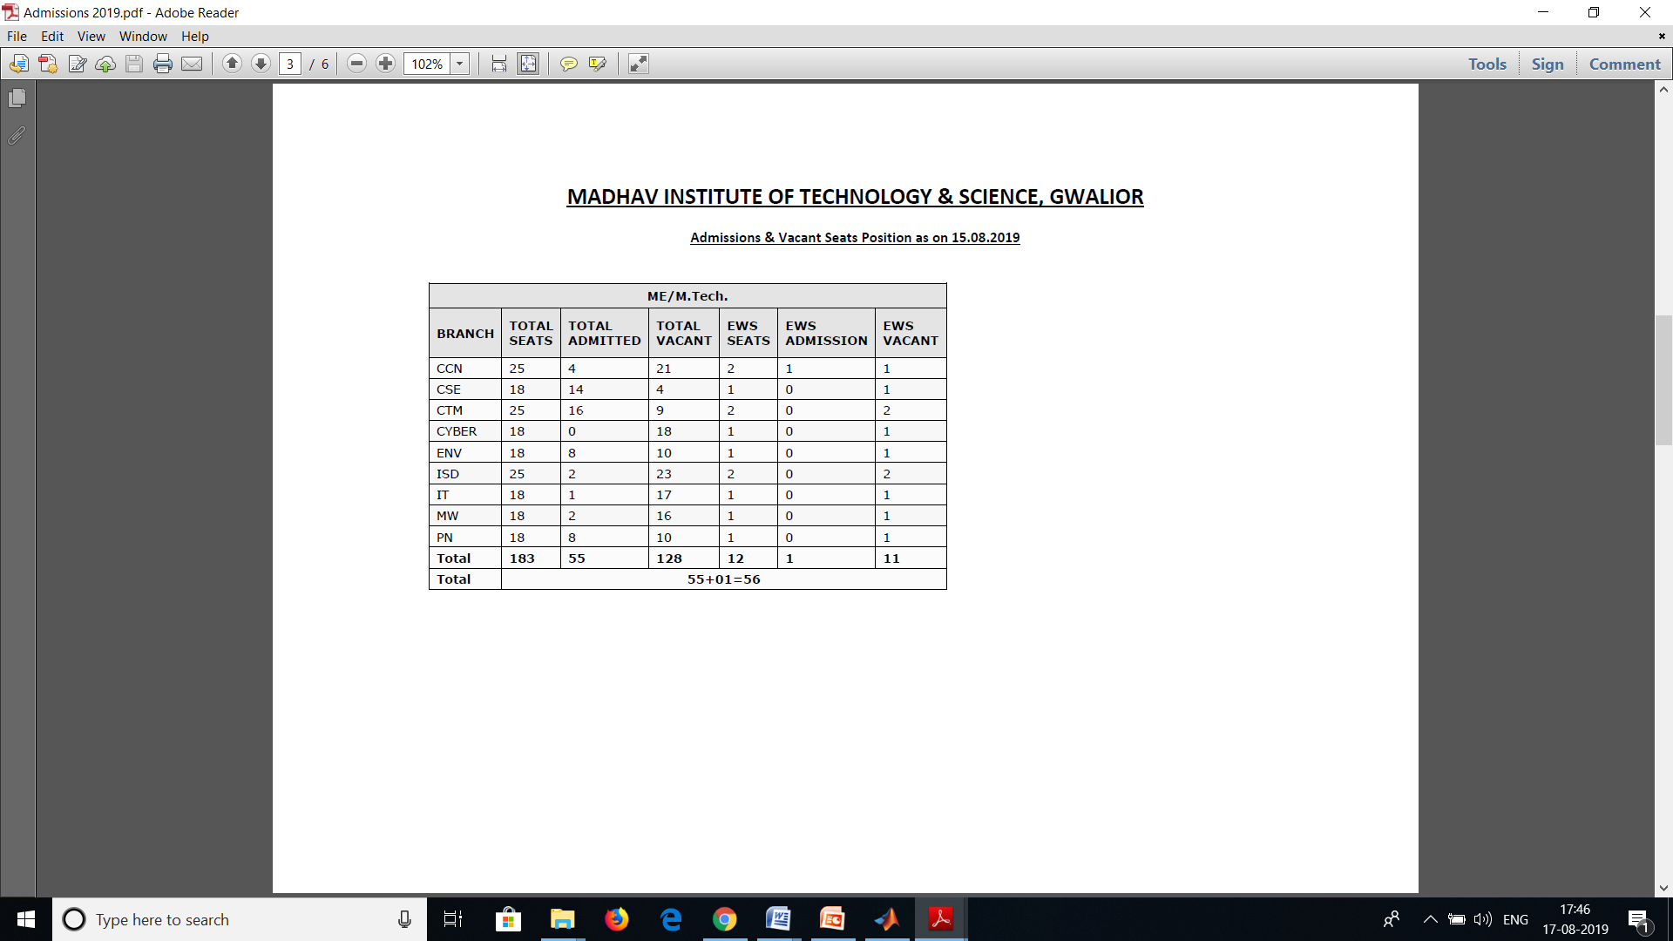
Courses Being Offered at MITS
UNDER GRADUATE(UG) PROGRAMMES
POST GRADUATE (PG) PROGRAMMES

Slide 8
Flexible Curriculum
(Drafted & Implemented in accordance with AICTE model curriculum guidelines)
TERMINOLOGY
L | Lecture
T | Tutorial
P | Practical
HSMC | Humanities and Social Sciences including Management Courses
BSC | Basic Science Courses
ESC | Engineering Science Courses
DC | Departmental Core
DE | Departmental Elective
OC | Open Category
DLC | Departmental Laboratory Courses
MC | Mandatory Course

Slide 9
Flexible Curriculum
(Implemented w.e.f. Academic Session July 2017)
What does one Credit Mean ?
1 Hour Lecture (L) / week | 1 credit
1 Hr. Tutorial (T) / week | 1 credit
2 Hours Practical(Lab) /week | 1 credit
Requirement of Credits for U.G. Degree, Honours & Minor Specialization
For Engineering | For Undergraduate Degree (Engineering) | Minimum 170 Credits
 | Under Graduate degree with Honours or with additional minor specialization | Additional 20 Credits
For Architecture | For Undergraduate Degree (Architecture) | Minimum 260 Credits
 | Under Graduate degree with Honours or with additional minor specialization | Additional 24 Credits

Slide 10
Structure of Undergraduate Engineering Program
S. No. | Category of Courses | Component wise credit allotment** No. | No. of Courses | Weightage (Percentage)
1 | Humanities and Social Sciences including Management Courses (HSMC) | 12 | 04 | 7
2 | Basic Science Courses (BSC) | 20 | 05 | 11.7
3 | Engineering Science courses including workshop, drawing, basics of electrical/mechanical/computer etc. (ESC) | 21 | 06 | 12.3
4 | Departmental Core Courses (DC) | 52 | 14 | 30.6
5 | Departmental Elective Courses (DE) | 20 | 05 | 11.8
6 | Open Category- Electives from other branches (OC) | 15 | 05 | 8.9
7 | Project work, seminar and internship in industry or appropriate work place/ academic and research institutions. (DLC/SWAYAM/NPTEL/MOOC) | 22 | 13 | 13
8 | Mandatory Course (MC) | 08 | 03 | 4.7
 | Total | 170 | 55 | 100

Slide 11
Structure of Undergraduate Architecture Program
S. No. | Code | Category | %Weightage as per CoA norms (2017 regulations) | No of courses | Total credits | Weightage (Percentage)
1 | DC | Departmental(Professional ) Core Courses | 45 | 19 | 127 | 48.5
2 | BSAE | Building Science & Applied Engineering Courses | 20 | 14 | 57 | 22
3 | DE | Departmental(Professional) Elective Courses | 10 | 07 | 31 | 8
4 | OC | Open Category Courses | 05 | 03 | 09 | 3.5
5 | PAEC | Professional ability enhancement course | 15 | 07 | 30 | 12
6 | SEC | Skill Enhancement Course | 5 | 11 | 15 | 6
 | TOTAL |  | 100 | 61 | 260 | 100
 | MC | Mandatory Course | Qualifier | 02(Audit) | 06 | -

Slide 12
The semester wise break-up of credits( Engineering & Architecture)
Semester | Credits |  | Weightage in percent
 | Engineering | Architecture | Engineering | Architecture
I | 21 | 27 | 12.35 | 10.4
II | 21 | 27 | 12.35 | 10.4
III | 24 | 27 | 14.12 | 10.4
IV | 25 | 27 | 14.71 | 10.4
V | 24 | 27 | 14.12 | 10.4
VI | 24 | 26 | 14.12 | 10
VII | 18 | 27 | 10.58 | 10.4
VIII | 13 | 26 | 7.65 | 10
IX | NA | 18 | - | 6.9
X | NA | 28 | - | 10.7
TOTAL | 170 | 260 | 100 | 100

Slide 13
GROUP A: I Semester & GROUP B: II Semester W.E.F JULY 2018
Subject wise distribution of marks and corresponding credits
Subject Code | Category | Course Name | Maximum Marks Allotted |  |  |  |  | Total Marks | Contact Hours per week |  |  | Total Credits
 |  |  | Theory Slot |  |  | Practical Slot
 |  |  | End Sem. | Mid Sem Exam. | Quiz/ Assignment | End Sem. | Lab work & Sessional |  | L | T | P
100201 | BSC | Engineering Physics | 70 | 20 | 10 | 30 | 20 | 150 | 2 | 1 | 2 | 4
100202 | HSMC | Energy, Environment, Ecology & Society | 70 | 20 | 10 | - | - | 100 | 3 | - | - | 3
100203 | ESC | Basic Computer Engineering | 70 | 20 | 10 | 30 | 20 | 150 | 3 | - | 2 | 4
100204 | ESC | Basic Mechanical Engineering | 70 | 20 | 10 | 30 | 20 | 150 | 3 | - | 2 | 4
100205 | ESC | Basic Civil Engineering & Mechanics | 70 | 20 | 10 | 30 | 20 | 150 | 3 | - | 2 | 4
100206 | HSMC | Language Lab. & Seminars | - | - | - | 30 | 20 | 50 | - | - | 4 | 2
 |  | Total | 350 | 100 | 50 | 150 | 100 | 750 | 14 | 1 | 12 | 21
Induction programme of 3 weeks/15 days (MC): Physical activity, Creative Arts, Universal Human Values, Literary, Proficiency Modules, Lectures by Eminent People, Visits to local Areas, Familiarization to Dept./Branch & Innovations

Slide 14
GROUP B: I Semester & Group A: II Semester W.E.F JULY 2018
Subject wise distribution of marks and corresponding credits
Subject Code | Category | Course Name | Maximum Marks Allotted |  |  |  |  | Total Marks | Contact Hours per week |  |  | Total Credits
 |  |  | Theory Slot |  |  | Practical Slot
 |  |  | End Sem. | Mid Sem. | Quiz/ Assignment | End Sem | Lab work & Sessional |  | L | T | P
100101 | BSC | Engineering Chemistry | 70 | 20 | 10 | 30 | 20 | 150 | 3 | - | 2 | 4
100102 | BSC | Mathematics-I | 70 | 20 | 10 | - | - | 100 | 3 | 1 | - | 4
100103 | HSMC | Technical English | 70 | 20 | 10 | 30 | 20 | 150 | 3 | - | 2 | 4
100104 | ESC | Basic Electrical & Electronics Engineering | 70 | 20 | 10 | 30 | 20 | 150 | 3 | - | 2 | 4
100105 | ESC | Engineering Graphics | 70 | 20 | 10 | 30 | 20 | 150 | 2 | - | 2 | 3
100106 | ESC | Manufacturing Practices | - | - | - | 30 | 20 | 50 | - | - | 2 | 1
 |  | Total | 350 | 100 | 50 | 150 | 100 | 750 | 14 | 1 | 10 | 20
TWO Credits for Summer Internship Project –I (Institute Level) (Qualifier): 2-week duration-Evaluation in III Semester

Slide 15
GROUP A & B
GROUP A
Electrical
Electronics
Computer Science
Information Technology
Electronics & Telecommunication
GROUP B
Civil
Mechanical
Chemical,
Automobile

Slide 16
ON-line courses through SWAYAM &MOOC
SWAYAM is an acronym which stands for “Study Web of Active learning by Young and Aspiring Minds”.
MOOC stands for “Massive Open Online Course”
In the Flexible Curriculum the additional credits for Honours/minor specialization can be acquired through MOOCs/SWAYAM courses.

Slide 17
Credit Requirements & Guidelines for MOOCs
Massive Open On-line Courses (MOOCs)
Additional Credit requirement : 20 additional Credits for Engineering & 24 Credits for B. Architecture students can be earned through MOOcs for getting an Honours or Minor Specialization
Out 0f 170 up to 34 Credits (20%) for Engineering/Technology students can be through MOOCs
52 credits out of total 260 credits for B. Architecture students can be through MOOCs
Studentsof B.Tech aspiring for minor specialization or Honours during the tenure of B. Tech programme can opt for a total of 54 (34+20) Credits
Students of the B. Architecture programme can earn up to 72 (52+20) credits through SWAYAM/NPTEL/MOOC platform based learning.

Slide 18
Flexible Curriculum Guidelines Continued..
The list of courses which the students can opt from the SWAYAM/ NPTEL/ MOOC platform against DE & OC courses in the scheme will be displayed on the website well in advance, (in November & May) so that students can select the courses of their choice.
Each such Course must be of minimum 2 credits.
There is a provision of 03 Mandatory Credit Courses on Cyber Security, Disaster Management, & Intellectual Property Rights
In the flexible curriculum presently there is a provision of 02 Audit Courses on (i) Biology for Engineers & (ii) Indian Constitution & Traditional Knowledge.
Auditing a course allows a student to take a class without the benefit of a grade or credit, for the sole purposes of self-enrichment and academic exploration.
The students have to undergo three Mandatory Summer Internship Programme/Projects (SIPs) after their I, II and III year
Their evaluation will reflect in III, V, & VII semester examination results, respectively.

Slide 19
Flexible Curriculum Guidelines Continued..
Credit will be given for “Professional Development” of students to encourage student participation in professional chapter activities, club activities, cultural events, sports, technical events hackethons, personality development activities etc.
The marks for “Professional Development” will be awarded to students in VIII semester on the basis of their participation and achievements in extra & co-curricular activities, sports, performance in MOOCs etc. right from I year.
Provision of Internship / Project
All the courses offered in VIII semester are DE (Departmental Elective) and OC (Open Category) courses, which will run through online learning platform under the mentorship of faculty members.
The students can opt for internship / project in the VIII Semester by either making a project or by doing internship in an industry after formal approval of the Institute as well as the concerned industry.

Slide 20
Projects/Internships for increasing exposure to practical problems & Student Employability
S.No. | Detail | Hours | Year of Internship | Evaluation
1. | Summer Internship Project-I (Institute Level) | 60 Hours | At the end of I Year | III Semester (02 Credits)
2. | Summer Internship Project-II (Soft Skills) | 90 Hours | At the end of II Year | V Semester (03 Credits)
3. | Summer Internship Project -III (On Job Training) | 150 Hours | At the end of III Year | VII Semester (02 Credits)
4 | Minor/Major Projects in Pre-final& Final year |  |  | 06 Credits
5 | Provision of Internship for full VIII semester |  |  | 03 Credits

Slide 21
Professional Development continued......
For Extra & Co-Curricular Curricular Activities
There are 50 different clubs for students
01 Credit allotted
for
IPROFESSIONAL DEVELOPMENT
(One Credit’ at the 8th semester is allotted for ‘Innovative Technical Contribution’ to motivate, inspire and recognize student participation at National/ International level technical events during the entire tenure of the UG programme)

Slide 22

Guidelines for evaluating “Professional Development”
PERFORMANCE METRICS
Categories | Suggestive Activities | Marks Assigned
Institute Level* (C1) | Participation in Institute level technical events such as quizzes, extemporary, debate, student volunteers, seminar, professional society local chapters (IET,IEEE,ISTE,IETE),NCC, etc. | 02 Marks for each participation (maximum 06)
State Level* (C2) | Participation in State level technical events such as Robotics, Coding challenge, Cultural cum technical fest, technical symposium, volunteers, hackathon, sports etc. | 03 marks for each participation (Maximum 09)
National level* (C3) | Participate in National level events such as hands on workshop, national level seminar, national conference, Entrepreneurship, model making, techno culture fest, national youth festival, research conclave, project competition, volunteers, sports festival etc. | 05 marks for each participation (Maximum 15)
MOOC’s** (C4) | Successfully completed technical certification course in any MOOC’s platform such as (NPTEL/SWAYAM/EdX/Coursera/Class Central etc) | 10 marks for each course (Maximum 20)
Evaluation
Formula for evaluation in VIII Semester |  | Marks Scored (Out of 50)
( C1x2 + C2x3 + C3x5 +C4x10)=

Slide 23
ACCREDITATION & OUTCOME BASED EDUCATION (OBE)
The Govt. of India signed the Washington Accord in June 2014 for coming at par with the technical institutes all over the world.
Course Outcomes (COs) are listed for each course. COs are abilities which a student is expected to achieve at the end of the course
Programme Outcomes (POs) are attributes which the students are expected to obtain at the end of graduation
Engineering knowledge
Problem analysis
Design & Development of Solutions
Investigation of Complex Problem
Modern tool usage
Engineer and society
Environment& sustainability
Ethics
Individual & team work
Communication
Lifelong learning
Project management & finance
Programme Educational Objectives (PEOs) are qualities which are expected to be achieved by the students about 3-5 years after graduation

Slide 24
Mapping between PEOs,POs and COs
COs
♦
GAs
♦
♦
♦
*
POs
*
*
+
.
*
+
+
.
.
Mission
*
*
.
+
*
+
+
Vision
*
*
+
PEOs
*

Slide 25
Academic feedbacks & surveys
On-line feedback on teachers (during mid-sem exams)
On-line feedback on courses being run (October & May)
On-line feedback on course outcomes (end of course)
Feedback by parents (during parent teacher meeting)
(At the time of your graduation)
On-line feedback on Programme Outcomes (POs)
Exit survey
(3-5 years after Graduation)
Alumni satisfaction survey

Slide 26
Awareness about Ethics & Academic Integrity
Criteria for accepting similarity index for the submission of UG project report/ PG dissertation/thesis
The overall similarity index up to 15-20% is acceptable (using turnitin plagiarism check software).
The highest similarity percentage from any one source is not greater than 4-6%.
In case of self plagiarism, the permissible percentage may be slightly higher, say at 7-10%.

Slide 27
PROMOTION TO HIGHER SEMESTER AND YEAR
To pass a particular course the minimum required grade is D (at least 31% marks).
The candidate should also separately score minimum of grade D in end semester examinations of theory and practical parts of
the course.
A candidate who has appeared in the examination of odd semester of a particular year, will automatically be promoted to even semester of that year irrespective of failing in any number of courses of previous semester.

Slide 28
PROMOTION Continued…..
A candidate who fails to score minimum of grade D in more than five courses (Theory and Practical of the same course shall be treated as two courses) in a particular year, shall not be admitted to the next higher year.
For the award of degree minimum Cumulative Grade Point Average (CGPA) required is 5.0.

Slide 29
PROMOTION Continued…
A candidate shall not be admitted in the fifth or higher semester classes unless he/she has fully passed the first year examination with minimum of CGPA of 5.0.
Also a candidate shall not be admitted in seventh or higher semester classes unless he/she has fully passed first and second year examinations with minimum CGPA of 5.0.

Slide 30
Credit based grading system (UG: Engineering)
Grade | % Marks range (based on absolute marks system) | Grade Point | Description of performance
A+ | Greater than 90-100 | 10 | Outstanding
A | Greater than 80-90 | 9 | Excellent
B+ | Greater than 70-80 | 8 | Very Good
B | Greater than 60-70 | 7 | Good
C+ | Greater than 50-60 | 6 | Average
C | Greater than 40-50 | 5 | Satisfactory
D | Greater than 30-40 | 4 | Marginal
F | 30 and below | 0 | Fail
I |  | 0 | Incomplete
W |  | 0 | Withdrawal

Slide 31
Credit based grading system
Bachelor of Architecture
Grade | % Marks range (based on absolute marks system) | Grade Point | Description of performance
A+ | Greater than 90-100 | 10 | Outstanding
A | Greater than 80-90 | 9 | Excellent
B+ | Greater than 70-80 | 8 | Very Good
B | Greater than 60-70 | 7 | Good
C+ | Greater than 50-60 | 6 | Average
C | Greater than 45-50 | 5 | Satisfactory
D | Only 45 | 4.5 | Marginal
F | Below 45 | 0 | Fail
I |  | 0 | Incomplete
W |  | 0 | Withdrawal

Slide 32
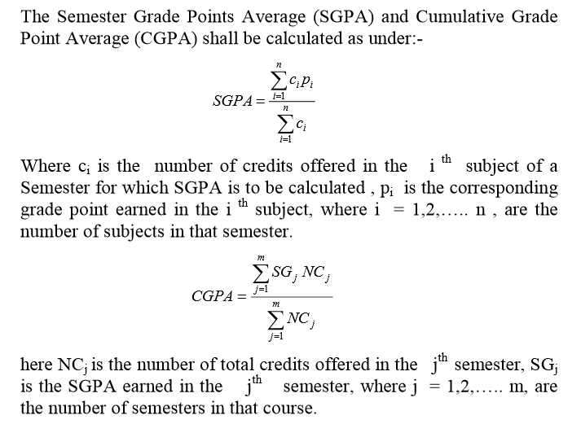
Semester Grade Points Average(SGPA)
& Cumulative Grade Points Average(CGPA)

Slide 33
Calculation of SGPA: an Example
 | Credits Allotted | Grade Received | Grade point
Course 1 | 4 | A+ | 10
Course 2 | 3 | B+ | 8
Course 3 | 4 | C+ | 6
Course 4 | 2 | A | 9
SGPA= ((4x10)+(3x8)+(4x6)+(2x9)) /(4+3+4+2) = 8.15

Slide 34
Calculation of CGPA
 | SGPA | Total Credits
Semester 1 | 8.15 | 13
Semester 2 | 8.5 | 15
Semester 3 | 7.5 | 12
Semester 4 | 8.2 | 14
CGPA= ((8.15x13)+(8.5x15)+(7.5x12)+(8.2x14)) /(13+15+12+14) = 8.11

Slide 35
MID SEMESTER TESTS AND QUIZES
Each student will appear in two mid-semester tests compulsorily. The evaluation will be based on average performance.
There will be a third Mid-semester examination also for those who could not appear in one of the two mid-semester tests due to some valid reason.
On-line quiz will be conducted in each course on institute MOODLE

Slide 36
Values, Ethics, Awareness of Societal Problems/Issues
Mandatory Courses (MC) : Ethics Environmental Science, Disaster Management, Intellectual Property Rights (IPR) and Cyber Security
Audit Courses : ‘Biology for Engineers’ and ‘Indian Constitution & Traditional Knowledge’
( It will be compulsory to acquire the specified credits in these courses by securing the minimum pass marks. However, these credits will not be counted in the aggregate credits.)

Slide 37
Innovation & Personality Development
Professional Society Chapters Available
Indian Society for Technical Education (ISTE)
Computer Society of India (CSI)
Association for Computing Machinery (ACM)
Institution of Electronics and Telecommunication Engineers(IETE)
Institution of Engineering and technology (IET)
The Institution of Electrical and Electronics Engineers (IEEE)
Society for Automobile Engineers of India (SAE INDIA)

Slide 38
Institute MOODLE
MOODLE is (Modular Object-Oriented Dynamic Learning Environment)
The institute has its own MOODLE which is very well utilized.
All the new students will be required to register and login to MOODLE
Students are required to check their attendance regularly on MOODLE. If your attendance falls short, you will not be permitted to appear in exams.
In case of any difficulty the students can contact the MOODLE server administrator Shri Atul Chauhan (moodle@mitsgwalior.in)
Once they are registered, they can access
Learning material such as Lecture plans, syllabi, Notes, PPTs, Unit Wise Question banks, previous year papers etc. on-line
On-line quiz, technical as well as aptitude based are also conducted on this platform

Slide 39
Remedial/bridge classes for clearing doubts
Doubt clearing sessions are conducted for all courses after the college hours and on working Saturdays
The time-table for these classes is displayed on the departmental notice boards
The students must contact their Class coordinator/ Head of the Department in case of any difficulty

Slide 40
Thank You
And wish you all a very happy and successful time in MITS ensuring a bright future

